Slide 2


Slide 5

Physical
Link
Source
Dest.
Network
Transport
Application

Slide 6

Physical
Link
Network
Transport
Application
Longitudinal wave in air

Slide 7
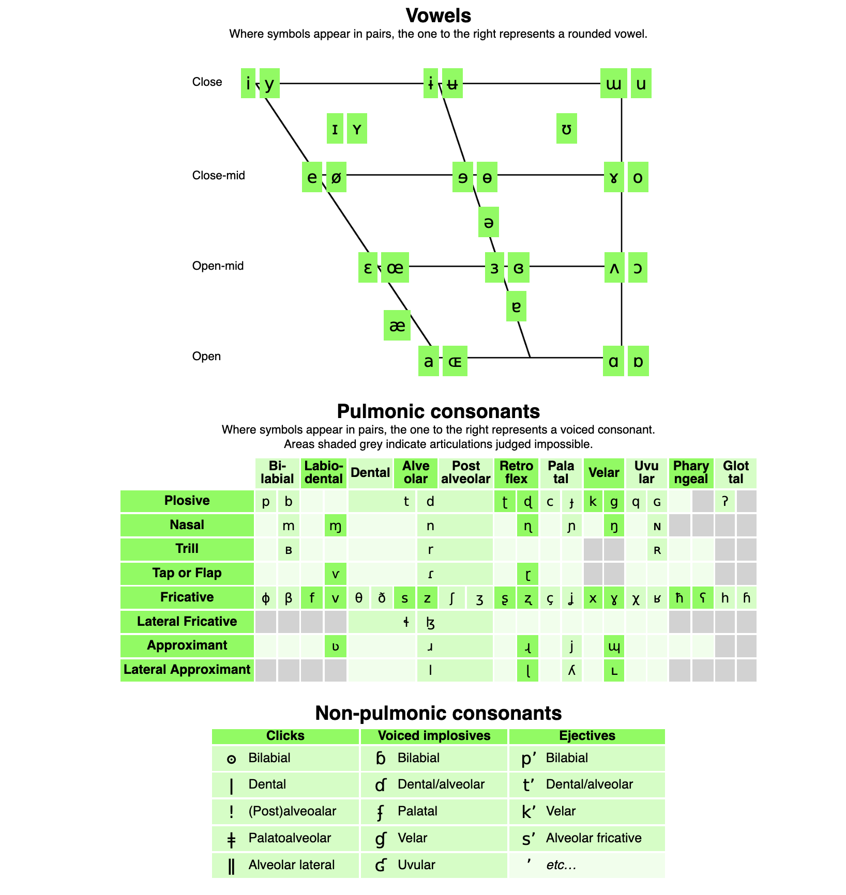
Physical
Link
Network
Transport
Application

Slide 8
wʊd ju æsk ˈdʒɛrəmi tə pæs ðə ˈpɑpkɔrn
Physical
Link
Network
Transport
Application
“Would you ask Jeremy to pass the popcorn?”

Slide 9

Physical
Link
Network
Transport
Application
Jason’s an idiot

Slide 10
Physical
Link
Network
Transport
Application
Jason’s an idiot Matt wants the popcorn

Slide 11

I wasn’t paying attention
Well, ask him again!
I think I have a chance with Beth!
What did Aaron say?
Physical
Link
Network
Transport
Application
Retransmission for reliability*
Notes:
This implies that retransmission happens at the data layer (which it can), but just note that we mean it over the entire network.

Slide 12
Physical
No!
Link
Pass the popcorn!
Network
Transport
Application
Overall meaning and purpose

Slide 13
Physical
Link
Would you ask Jeremy to pass the popcorn?
aux
subj.
verb
subj.
verb
object
Network
Main clause
Infinitive phrase
Sentence
Transport
Application

Slide 14
Layering
Computer Network Fundamentals
George Varghese - Fall 2024
Discussion - Week 0

Slide 15

Teaching Assistants
Omar Elamri Discussion 1A, 1B 1st year, Computer Science Masters omar@cs.ucla.edu
Office Hours: Boelter 3256S, Monday at 12:00-1:50 pm

Slide 16
What is discussion for?
Unlike most CS classes, we only have 50 minutes for discussion!
Very brief review of lecture’s content
Worksheet that reinforces said content
Project introductions/help
…maybe interactive activities?

Slide 17
Explicit Congestion Notification

Slide 18
Strict Layering
Host
Routers
Host
A
B
D
C
Source
80
22
Dest.
20
25
F
Eth
E
IP
TCP
Payload
I want to go to Dest.
I want to go to D
I want to access port 80

Slide 19
Strict Layering
Host
Routers
Host
Eth
A
Eth
IP
TCP
B
Payload
D
C
Source
80
22
Dest.
20
25
F
E

Slide 20
Strict Layering
Host
Routers
Host
A
Eth
B
Eth
IP
TCP
Payload
D
C
Source
80
22
Dest.
20
25
F
E

Slide 21
Strict Layering
Eth
Host
Routers
Eth
Host
IP
TCP
Payload
A
B
D
C
Source
80
22
Dest.
20
25
F
Should B be able to modify the TCP header?
E

Slide 22
Strict Layering
Host
Routers
Host
A
B
D
C
Source
80
22
Dest.
20
25
F
E
Eth
Eth
IP
TCP
Payload

Slide 23
Strict Layering
Host
Routers
Host
A
B
D
C
Source
80
22
Dest.
20
25
F
E
Eth
IP
TCP
Payload

Slide 24
Strict Layering
Host
Routers
Host
A
B
D
C
Source
Payload
80
22
Dest.
20
25
F
E

Slide 25
Firewalls
Does this violate strict layering?
❌
A
Eth
IP
TCP
25
Payload
80 ✅
443 ✅
Else ❌

Slide 26
Congestion Control
Routers may only modify IP headers (and below). How can R2 notify the source that congestion is occurring?
(Without violating strict layering.)
Source
R1
R2
Dest.
10 Gbps
10 Gbps
1 Gbps
Queue fills up; congestion

Slide 27
Worksheet

Slide 28
Explicit Congestion Notification
Interestingly enough, this is a real problem with a real solution!
Created in 2001 (RFC 3168)
Only truly supported in 2015 when Apple added it to all their operating systems
For more information, see this Wikipedia article.

Slide 29
Explicit Congestion Notification
A
B
R1
C
Source
Dest.
R2
IP
TCP
Payload

Slide 30
Explicit Congestion Notification
A
B
R1
C
Source
Dest.
R2
IP
11
TCP
Payload

Slide 31
Explicit Congestion Notification
A
TCP
B
Payload
R1
C
Source
Dest.
R2

Slide 32
Explicit Congestion Notification
A
IP
TCP
ECE
B
Payload
R1
C
Source
Dest.
R2

Slide 33
Explicit Congestion Notification
IP
TCP
ECE
Payload
A
B
R1
C
Source
Dest.
R2

Slide 34
Explicit Congestion Notification
IP
TCP
ECE
Payload
A
B
R1
C
Source
Dest.
R2

Slide 35
Explicit Congestion Notification
A
B
R1
C
Source
Dest.
R2
IP
TCP
ECE
Payload

Slide 36
Explicit Congestion Notification
Now the source knows to reduce its rate
A
B
R1
C
Source
Dest.
R2
TCP
ECE
Payload

Slide 37
Explicit Congestion Notification
A
B
R1
C
Source
Dest.
R2
IP
TCP
CWR
Payload

Slide 38
Explicit Congestion Notification
The destination stops sending packets with ECE
A
IP
TCP
CWR
Payload
B
R1
C
Source
Dest.
R2

Slide 39
Answers
Both!
The implication: must send forward
Explicit Congestion Notification

